Slide 1

IMAGE CLASSIFICATION ON CIFAR-100 USING TRANSFER LEARNING WITH EFFICIENTNET-B0
by Adams Ubini
University of Maryland Baltimore County

Slide 2
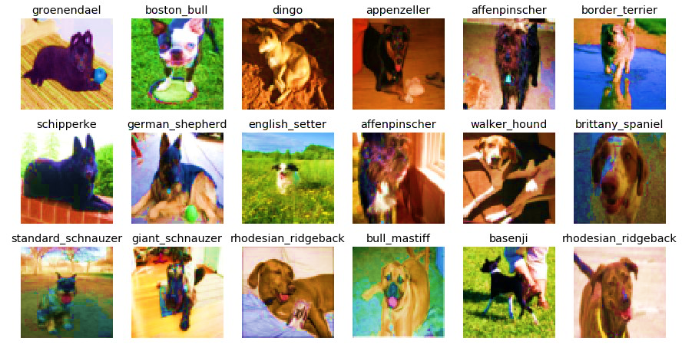
BACKGROUND ON THE DATASET
CIFAR-100 is a labeled subset of 80 million tiny images dataset where CIFAR stands for Canadian Institute For Advanced Research.
The dataset consists of 60000 colored images (50000 training and 10000 test) of $32 ×32$ pixels in 100 classes grouped into 20 super classes.
It has 100 classes containing 600 images each. There are 500 training images and 100 testing images per class.

Slide 3
METHODS AND EXPERIMENTS
Simple custom built CNN architecture
Transfer Learning
EfficientNet (Pre-Trained model)
ImageNet (Dataset)

Slide 4

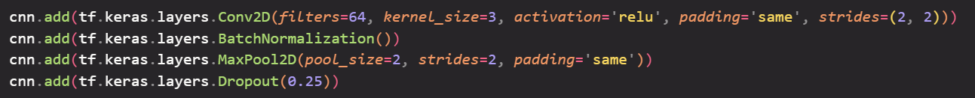

SIMPLE CUSTOM BUILT CNN ARCHITECTURE
Data Augmentation
Two Convolutional Layers
activation='softmax’
epochs = 25
optimizer = Adam(learning_rate=2.5000e-04),
loss = 'sparse_categorical_crossentropy',
metrics = ['accuracy']

Slide 5
TRANSFER LEARNING
Transfer learning is the improvement of learning in a new task through the transfer of knowledge from a related task that has already been learned.
In simple terms, transfer learning is a machine learning technique where a model trained on one task is re-purposed on a second related task.

Slide 6
EfficientNet
A technique achieving state-of-the-art image classification accuracy from Google AI research. This technique rethinks the way that we scale convolutional neural networks up.
Process of scaling up CNN’s is not well understood; many ways of doing this, mostly arbitratily chosen.

Slide 7
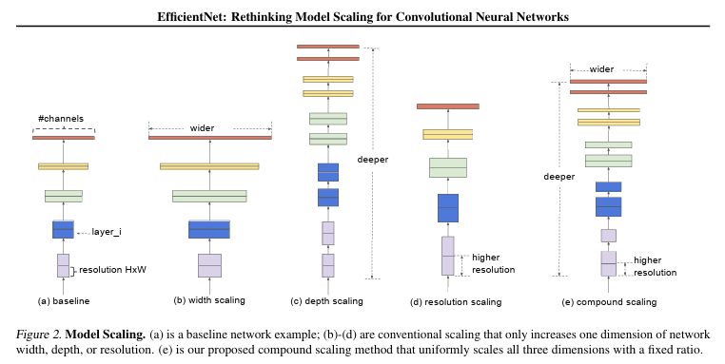
These are the three dimensions that they’re looking at with respect to scaling up cnns
Compound scaling refers to a combination of increasing the width adding more layers and increasing the input image resolution

Slide 8
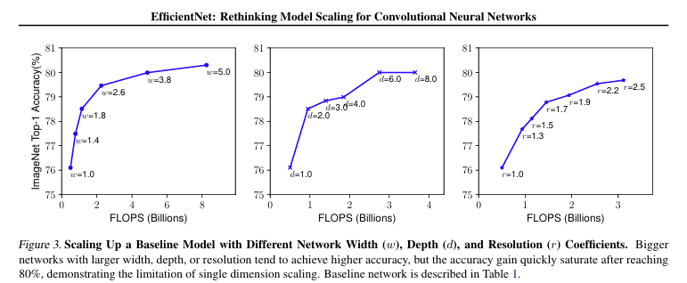

Slide 9
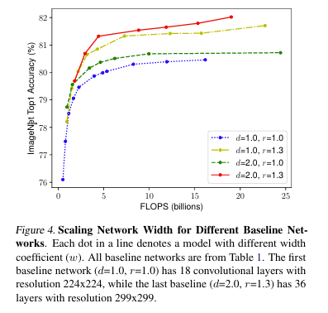
It was empirically observed that different scaling dimensions are not independent. Intuitively, “If the input image is bigger, then the network needs more layers to increase the receptive field and more channels to capture more fin-grained patterns on the bigger image”
A neuron's receptive field is the area of the input that affects its output value. As you go deeper into the layers of a CNN, each neuron starts to "see" a larger portion of the input image due to multiple layers of convolutions and pooling.

Slide 10
EfficientNet Conclusion
They “propose a simple and highly effective compound scaling method, which enables us to easily scale up a baseline ConvNet to any target resource constraints in a more principled way, while maintaining model efficiency.”

Slide 11
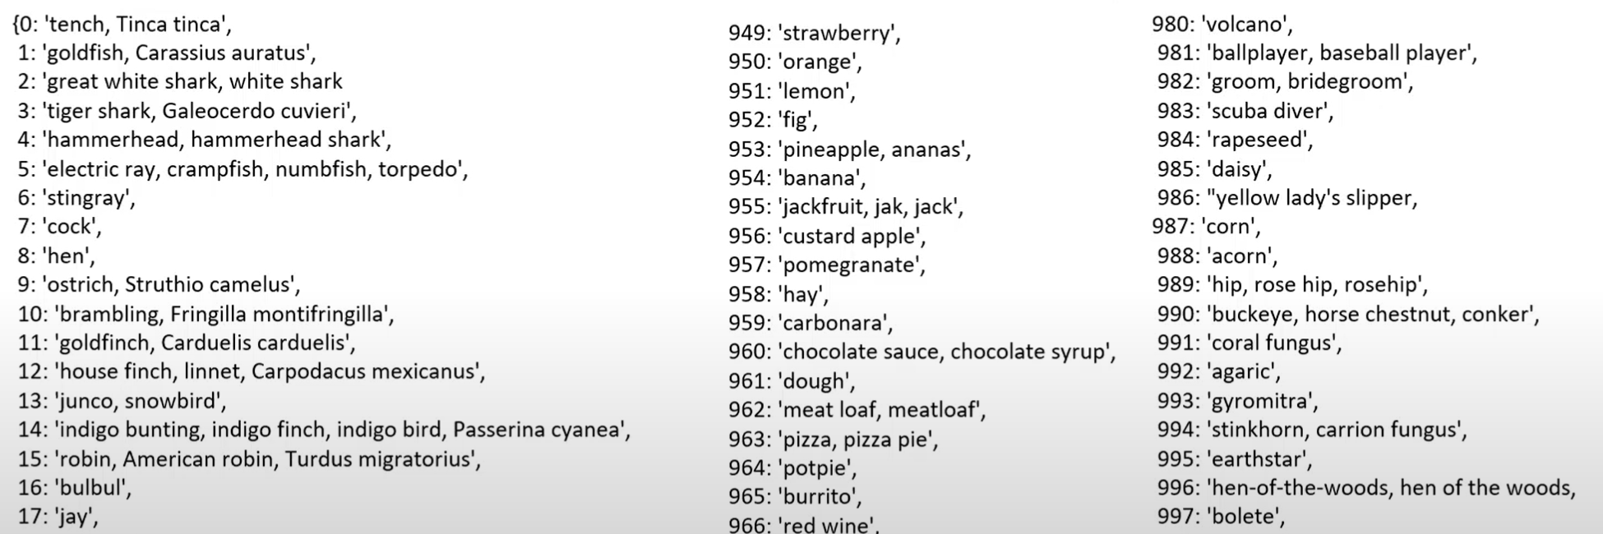
ImageNet
This dataset spans 1000 object classes and contains 1,281,167 training images, 50,000 validation images and 100,000 test images.

Slide 12
Transfer Learning with EfficientNetB7 on CIFAR-100 Architecture
The CIFAR-100 images were resized from 32×32 to 224×224 to match EfficientNet’s input requirements.
A custom data generator was implemented to handle image resizing, normalization, and optional augmentation.
The model was fine-tuned by adding a global average pooling layer, a dropout layer to prevent overfitting, and a final dense layer with SoftMax activation for 100-class classification.

Slide 13
Transfer Learning with EfficientNetB7 on CIFAR-100 Architecture
The network was trained using the Adam optimizer, with categorical Cross entropy loss, and performance was monitored using accuracy on both training and validation sets.
Early stopping and learning rate reduction on plateau were used to optimize training.

Slide 14
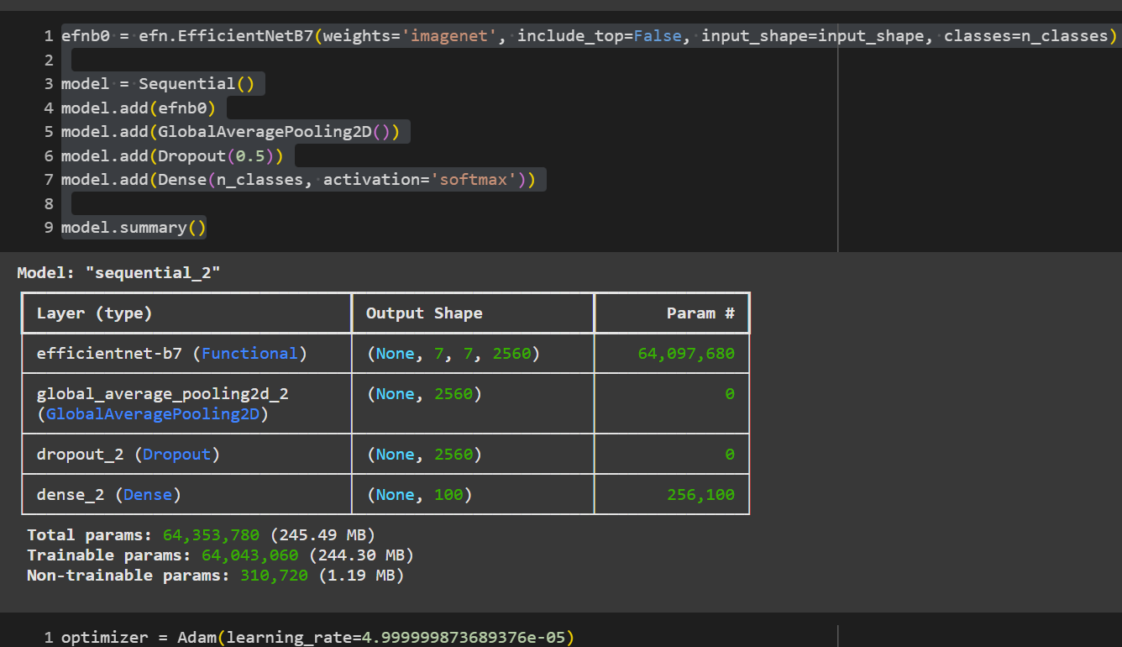
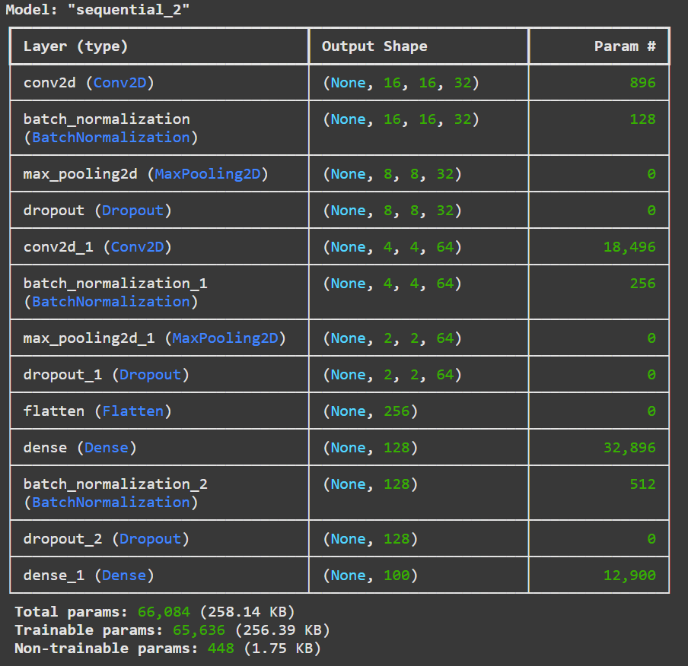
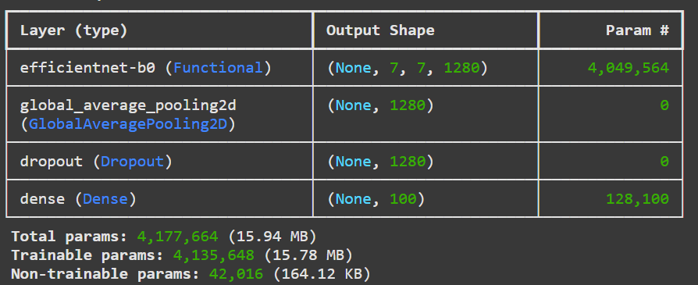

Slide 15
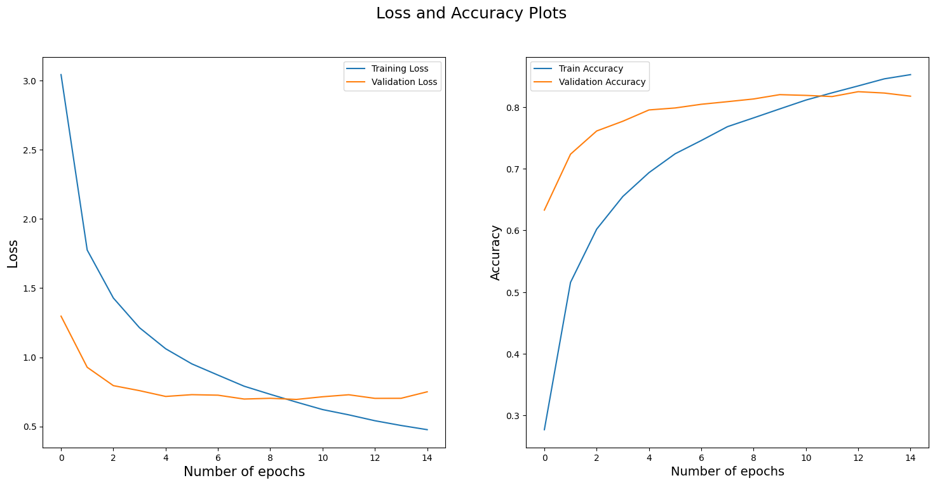


RESULTS

Slide 16
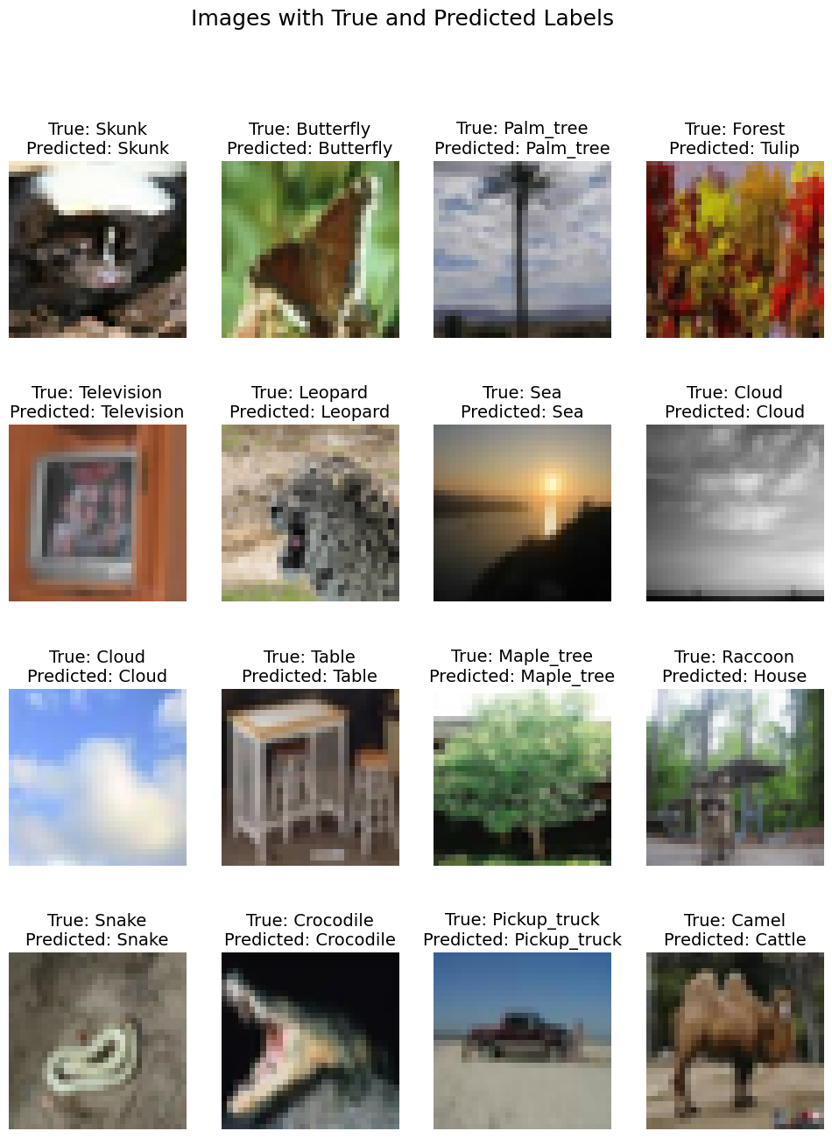
RESULTS

Slide 17
DISCUSSION
I used 224×224 resolution instead of 600×600 because I hadn’t researched EfficientNet’s scaling fully at first.
When I tried 600×600 later, it took ~30 minutes per epoch, which was too slow for my setup.

Slide 18
REFERENCES
Ahmed, R. (n.d.). What is ImageNet? [Video]. YouTube. https://youtu.be/gogV2wKKF_8
ImageNet. (n.d.). Download ImageNet data. Retrieved June 1, 2025, from https://www.image-net.org/download.php
Khanna, C. (2021, January 1). CIFAR-100: Pre-processing for image recognition task. Towards Data Science. https://towardsdatascience.com/cifar-100-pre-processing-for-image-recognition-task-68015b43d658/
Khanna, C. (2021, March 30). CIFAR-100 Transfer Learning using EfficientNet. Towards Data Science. https://towardsdatascience.com/cifar-100-transfer-learning-using-efficientnet-ed3ed7b89af2/

Slide 19
REFERENCES
Krizhevsky, A. (2009). Learning multiple layers of features from tiny images. University of Toronto. https://www.cs.toronto.edu/~kriz/cifar.html
Shorten, C. [Connor Shorten]. (2020, April 8). EfficientNet explained! [Video]. YouTube. https://youtu.be/3svIm5UC94I
Tan, M., & Le, Q. (2019, May). Efficientnet: Rethinking model scaling for convolutional neural networks. In International conference on machine learning (pp. 6105-6114). PMLR.

